Slide 1
RISC-V Pipelined Scalar Simulator
Finn Cooper – sd22404

Slide 2
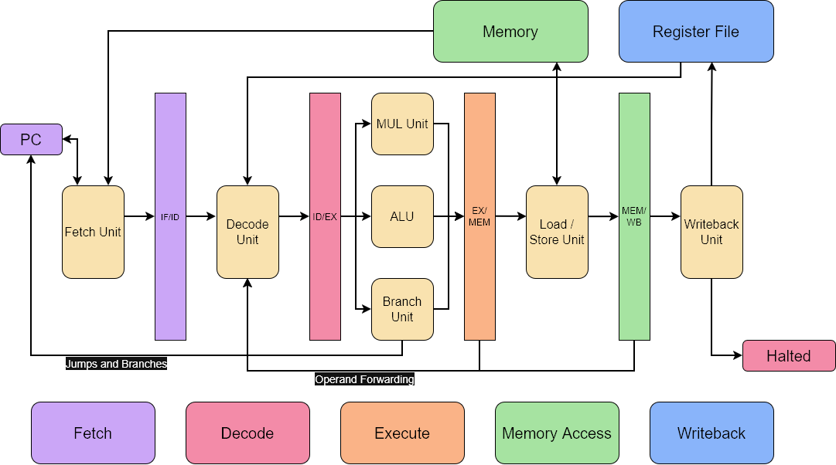
Microarchitecture

Slide 3
Features
RV32im – implemented base unprivileged ISA with multiply extension
Omitted ‘FENCE’ instructions, ECALL and EBREAK
5-stage pipeline
Fetch, Decode, Execute, Memory Access, Writeback
Operand Forwarding - stall only on load-use hazard if enabled
Otherwise stall for all data hazards
Pipeline flushing for control hazards
ELF file parsing with ‘elfio’ library
Compiles C programs to RISC-V ELF binary with riscv64-unknown-elf-gcc
TUI interface
Displays disassembly with instruction pointer for each pipeline stage
Displays registers and stack, with highlighted changes since the last cycle

Slide 4
Planned Improvements
Superscalar execution
Begin with 2-wide, later configurable
Branch prediction
Support for different dynamic algorithms
Reservation stations, reorder buffer & register renaming
Following Tomasulo’s algorithm
Support for 64-bit instructions (RV64)
Support for floating point instructions (“F” extension)
Support for vector instructions (“V” extension)

Slide 5
Planned Experiments & Benchmarks
Performance of branch prediction algorithms
Compare dynamic algorithms (e.g. one and two-bit saturation counters)
Compare best dynamic to static not-taken and static taken
Performance uplift of vector operations
Compare performance across benchmarks with vector extension enabled and disabled
Evaluation of pipeline width across benchmarks
Benchmarks
Sorting algorithms
Livermore Loops
Recursive algorithms

